Slide 1
Maze Runner
Name | ID
Nazia Afrin Neezi | 011 143 007
Shadman Shadab | 011 143 043

Slide 2
Introduction
A 2D/3D game where the player has to traverse through a maze to reach a goal.
Supports user created mazes
Solves any maze that has a valid solution

Slide 3
Tasks
Nazia | Shadab
2D View | 3D View
Dynamic Map Loading | Path finding
Compass | Text rendering
 | FPS Movement

Slide 4
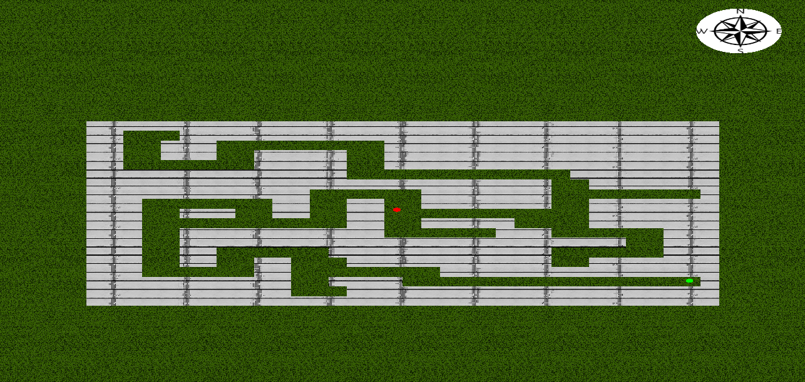
Screenshots

Slide 5
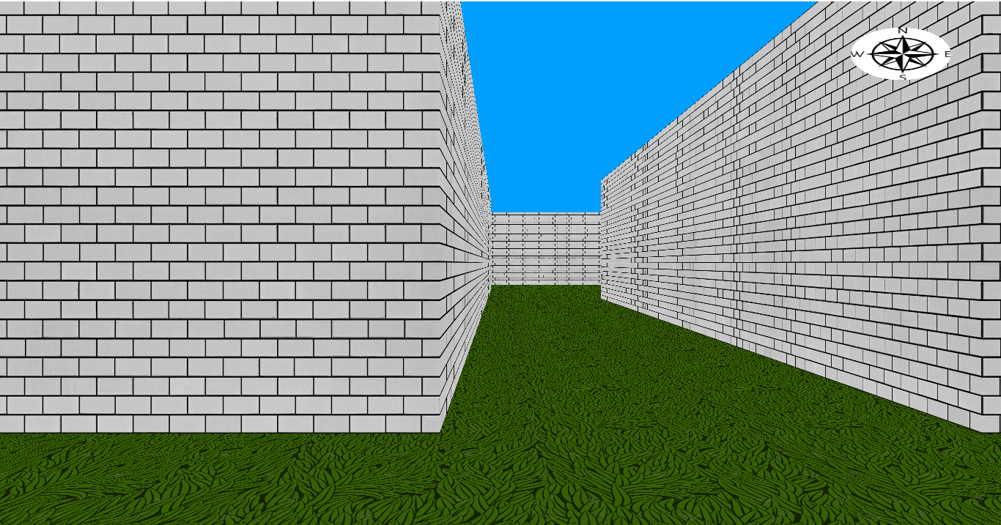
Screenshots

Slide 6
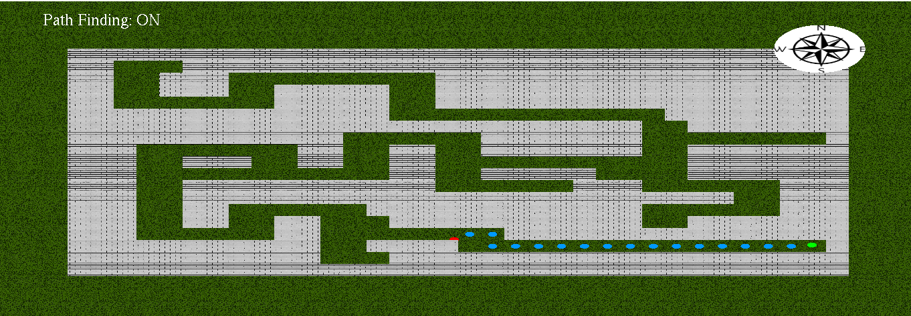
Screenshots

Slide 7
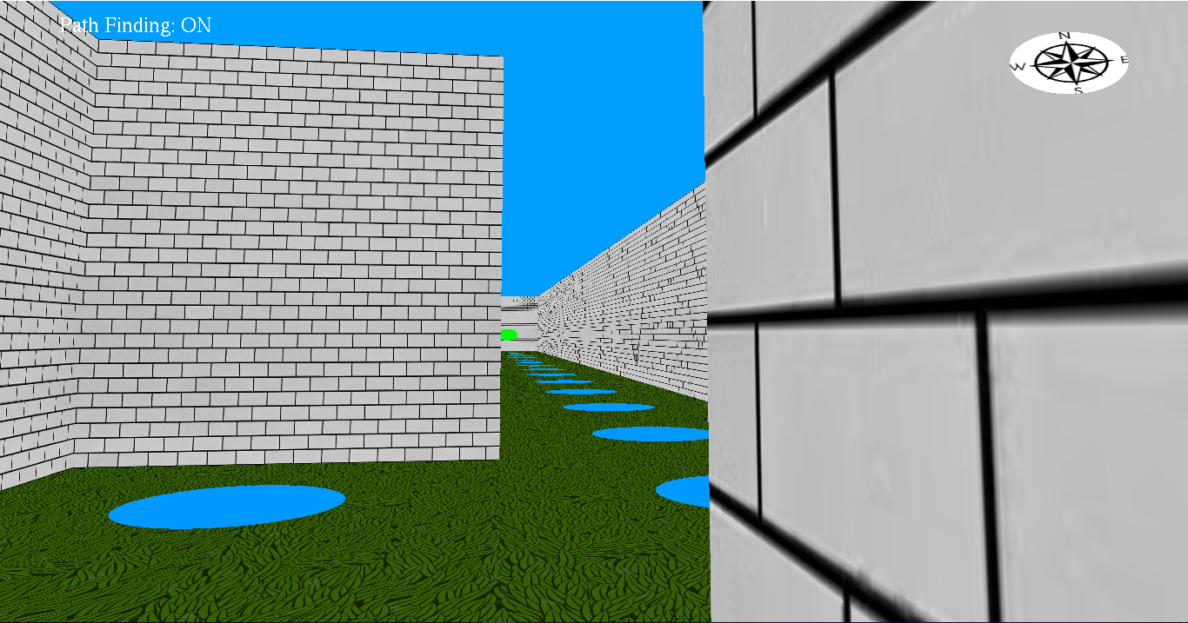
Screenshots

Slide 8
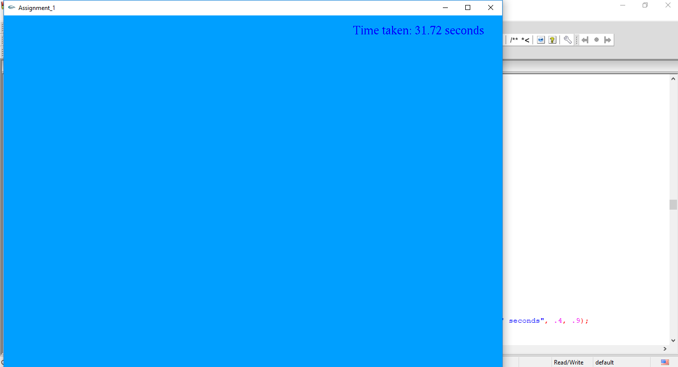
Screenshots

Slide 9
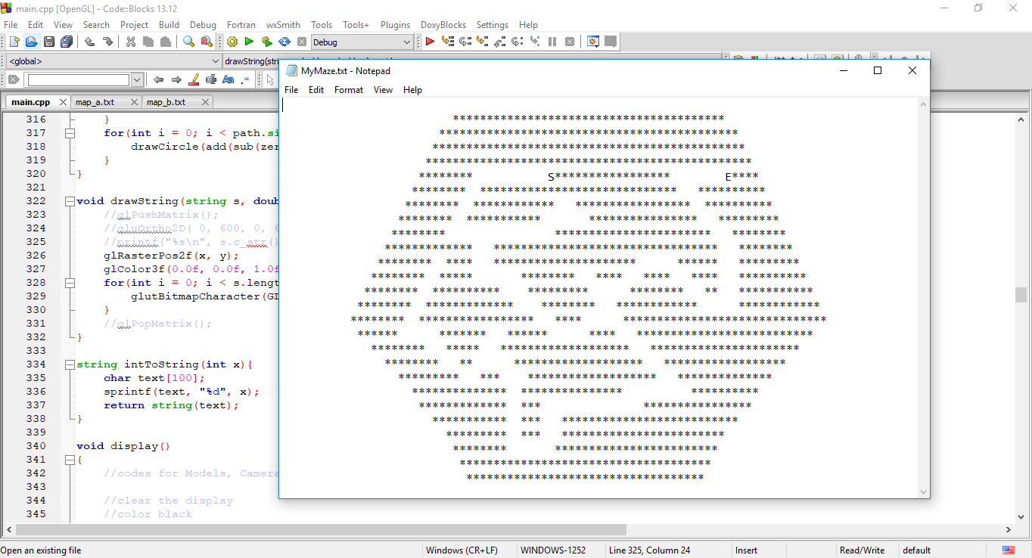
Screenshots

Slide 10
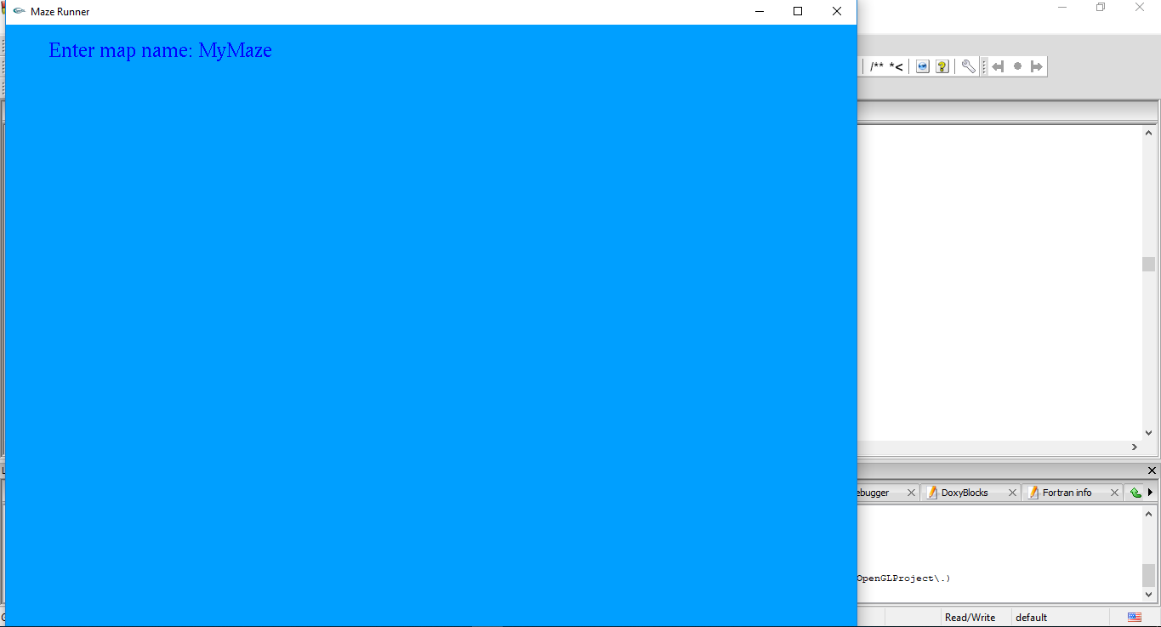
Screenshots

Slide 11
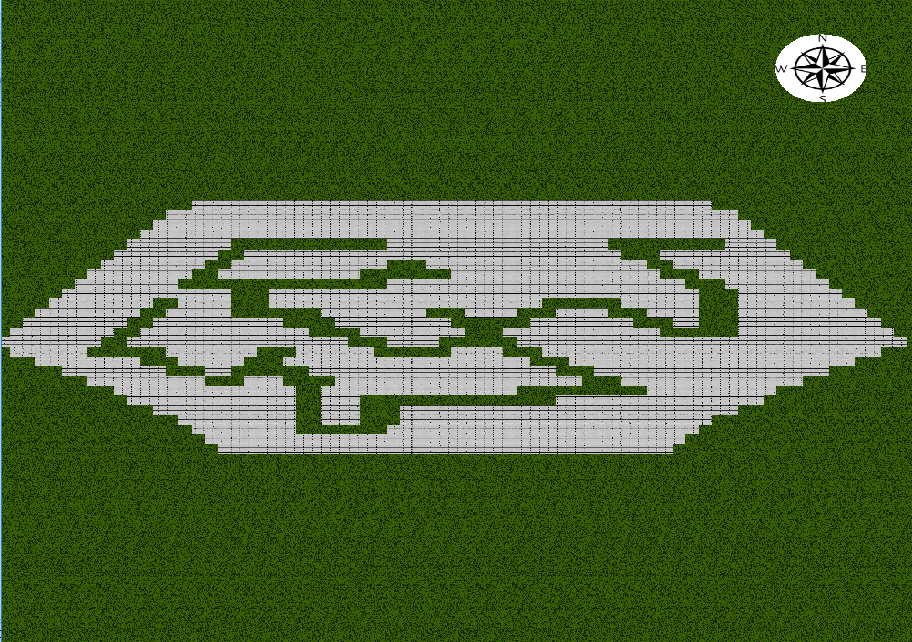
Screenshots

Slide 12
Thank you

